Slide 1
Python Anaconda Installation

Slide 2

Step - 01
Go to this link and download Anaconda for Windows, Mac, or Linux: – https://www.anaconda.com/products/distribution

Slide 3
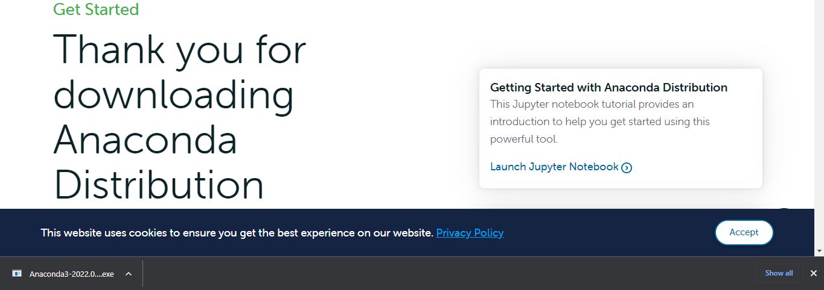
Step - 02
A file with exe extension will be downloaded. Click on it.

Slide 4
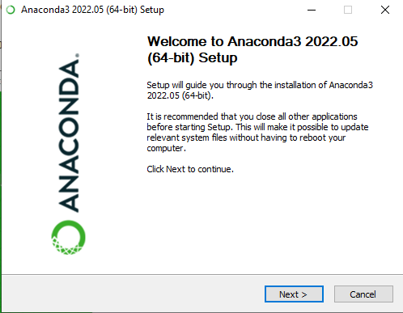
Step - 03
This is the Anaconda setup. Click next.

Slide 5
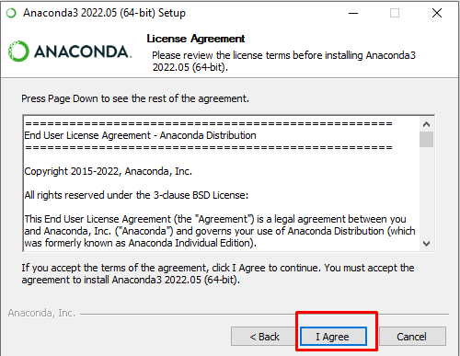
Step - 04
Now, you’ll see the license agreement. Click on ‘I Agree’.

Slide 6
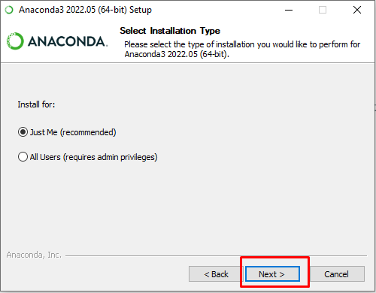
Step - 05
You can install it for all users or just for yourself. If you want to install it for all users, you need administrator privileges.

Slide 7
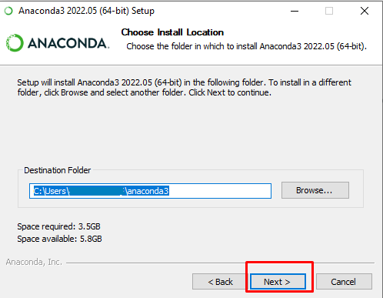
Step - 06
Choose where you want to install it. Here, you can see the available space and how much you need.

Slide 8
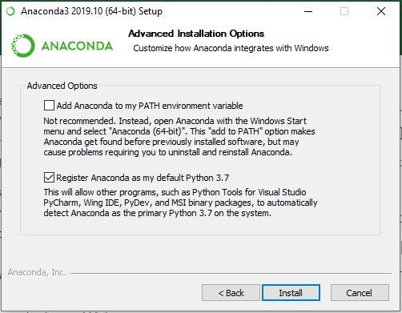
Step - 07
Now, you’ll get some advanced options. You can add Anaconda to your system’s PATH environment variable, and register it as the primary system Python 3.7. If you add it to PATH, it will be found before any other installation. Click on ‘Install’.

Slide 9
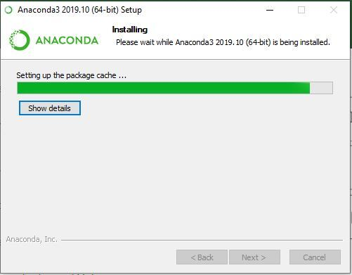
Step - 08
Installation process will begin.

Slide 10
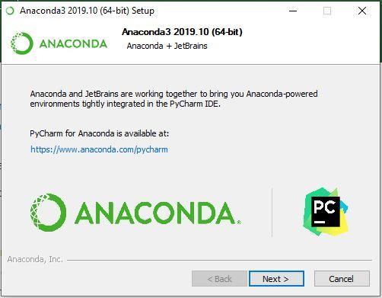
Step - 09
Click Next.

Slide 11
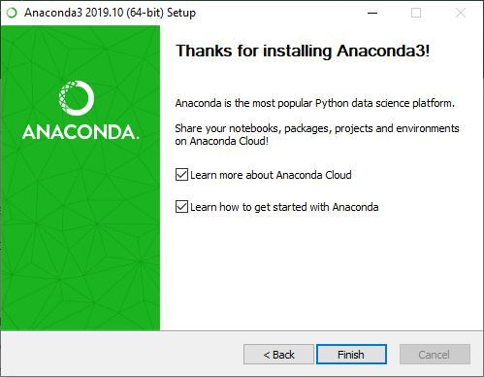
Step - 10
Finishing up the Installation

Slide 12
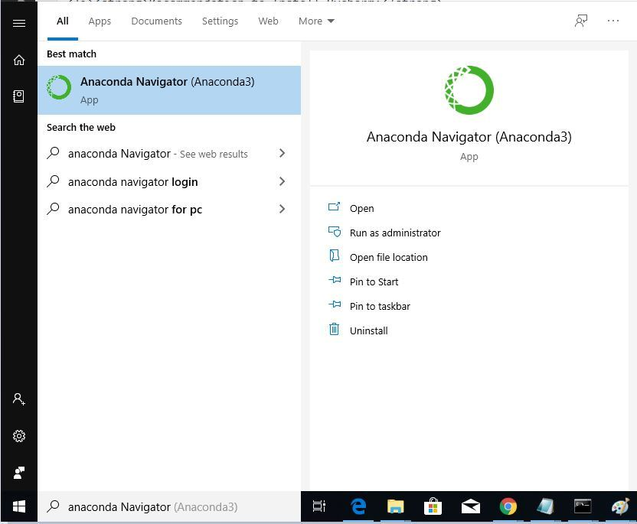
Working with Anaconda
Once the installation process is done, Anaconda can be used to perform multiple operations. To begin using Anaconda, search for Anaconda Navigator from the Start Menu in Windows

Slide 13
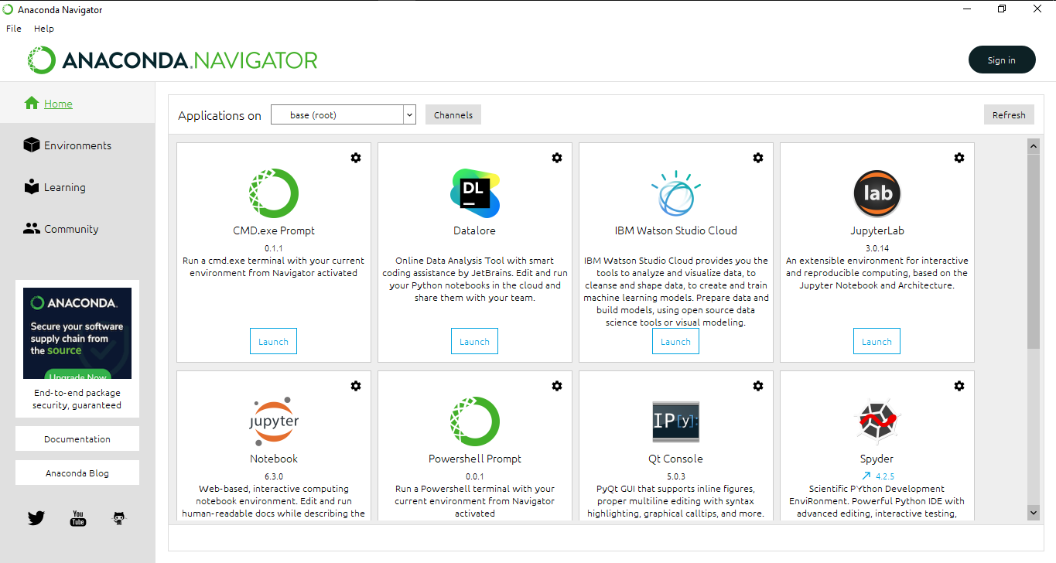

Slide 14
Thanks!
Do you have any questions?
Then must Comment here.

